Slide 1

“TO-DO LIST”
SRS

Slide 2

To-Do List
▪
It used to maintain our day-to-day tasks or list everything that we have to do, with the most important tasks at the top of the list, and the least important tasks at the bottom.
NM_ID
Name
Batch
au820420205010
S. Akshaya
CF1
au820420205031
S. Lithika Iswarya
CF1
au820420205002
M.Abarna
CF1
au820420205025
S. Jaishree
CF1

Slide 3
Learning Outcomes:
To-do list in full stack development is to be able to create a functional application that allows users to add, edit, and delete tasks, as well as mark them as complete or incomplete. This involves understanding the basics of full stack development, including front-end, middleware, and back-end development.
To create a To-do list application, one needs to have a strong understanding of HTML, CSS, and JavaScript, as well as knowledge of databases, frameworks, and programming languages.
The application should be able to store data in a database, retrieve it, and display it to the user in a user-friendly way. Additionally, the application should be responsive and accessible, allowing users to interact with it on different devices and platforms.
Finally, the application should be tested thoroughly to ensure that it is free of bugs and errors. By mastering these skills, one can become a proficient full stack developer capable of creating complex and functional applications.

Slide 4

Step-WiseꢀDescription
Project Planning: Define the project's goals and requirements. Decide on the features you want in your to-do list application, such as task creation, task deletion, and marking tasks as complete. Determine the technology stack you'll use for both the frontend and backend.
Set Up Your Development Environment: Install the necessary software and tools, including a text editor or integrated development environment (IDE), version control system (e.g., Git), and a web server for local testing.
Frontend Development: Create the user interface for your to-do list using HTML, CSS, and JavaScript. Implement features like adding tasks, marking tasks as complete, and deleting tasks. Ensure a responsive and user-friendly design for both desktop and mobile devices.
Backend Development: Choose a backend technology such as Node.js with Express, Ruby on Rails, Python with Django, or any other server-side framework. Implement APIs for creating, reading, updating, and deleting tasks. Set up a simple data structure or use a database for storing tasks (you can start with in-memory storage for simplicity).
Connecting Frontend and Backend: Configure API endpoints on the backend to handle requests from the frontend. Use JavaScript's Fetch API or a library like Axios to send and receive data between the client and server.

Slide 5
User Authentication (Optional): If desired, implement user registration and login functionality. Secure user data by hashing and salting passwords.
Testing: Test your application to identify and fix any bugs or issues. Write unit tests and integration tests to ensure the application's stability.
Deployment: Choose a hosting service (e.g., AWS, Heroku, Netlify) for both your frontend and backend. Deploy your application to make it accessible online.
Security: Implement security best practices, such as input validation, cross-site scripting (XSS) prevention, and securing API endpoints.
Performance Optimization: Optimize your application for speed and efficiency. This may include caching, minimizing database queries, and reducing unnecessary data transfer.
Documentation: Create user and developer documentation for your project to make it easy for others to understand and use.
Final Testing and Quality Assurance: Perform a final round of testing to ensure everything works as expected.
Launch and Maintenance: Launch your to-do list application and make it accessible to users. Continuously monitor, maintain, and update the application to improve and fix any issues that arise.
.

Slide 6
SUMMARY OF THE TASK
.
A To-Do List project in full-stack development involves creating a web application to manage tasks. It offers hands-on experience in both frontend and backend development, covering aspects like UI design, data storage, API development, and often includes optional user authentication.
This project helps learners develop practical skills in web development, version control, testing, and deployment, making it an excellent starting point for more complex web applications.

Slide 7
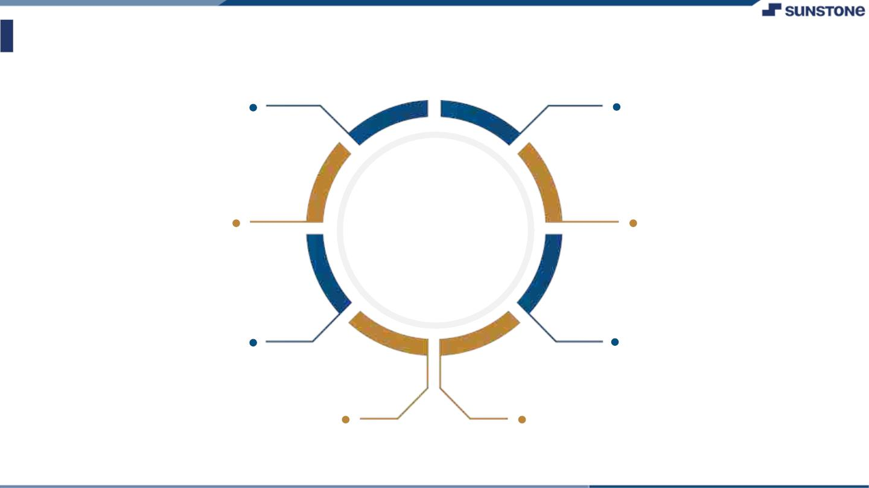
AssessmentꢀParameter
Gatherꢀrequirementsꢀforꢀtheꢀ
project
addꢀReadme.mdꢀfileꢀwithꢀ
descriptionꢀofꢀtheꢀproject
Prepareꢀdatabaseꢀdesignꢀ
schemas
Check-List
Commitꢀallꢀchangesꢀwithꢀ"firstꢀ
commit"
Getꢀyourꢀinitialꢀprojectꢀ
Structureꢀready
createꢀaꢀrepositoryꢀonꢀgithubꢀ
realtedꢀtoꢀproject
Initiateꢀaꢀgitꢀrepository
Pushꢀyourꢀchangesꢀtoꢀgithub

Slide 8
Taskꢀ-ꢀ1
CreationꢀofꢀSRSꢀ&ꢀGithub
▪
▪
▪
CreateꢀSRSꢀ:ꢀ“To-Do List”
Creationꢀ&ꢀSet-upꢀofꢀGithubꢀaccount
Creationꢀ&ꢀHands-onꢀtoꢀvariousꢀcommandsꢀofꢀGitꢀBash
EvaluationꢀMetric:
● 100%ꢀCompletionꢀofꢀtheꢀaboveꢀtasks
Learning Outcome
Gain experience with modern web development tools and technologies.
Learn how to build and deploy scalable and reliable web applications.
Improve your problem-solving and debugging skills.
Become a more well-rounded full stack developer.

Slide 9

Submission Github
Insert Your Github Link Here

Slide 10


